Slide 1
Group 9 Final Presentation
Hotel 9
Noël Hermans - 112012029
Oscar van Vugt - 112012036
TAO, Kuan-Cheng - 111590450

Slide 2
Index
Project Overview
Live Demo
Summary

Slide 3
Project Overview
Frontend and Backend website Hotel9
View and book rooms
Bootstrap
JS plugins (Datepicker, OwlCarousel, Scrollmagic)

Slide 4
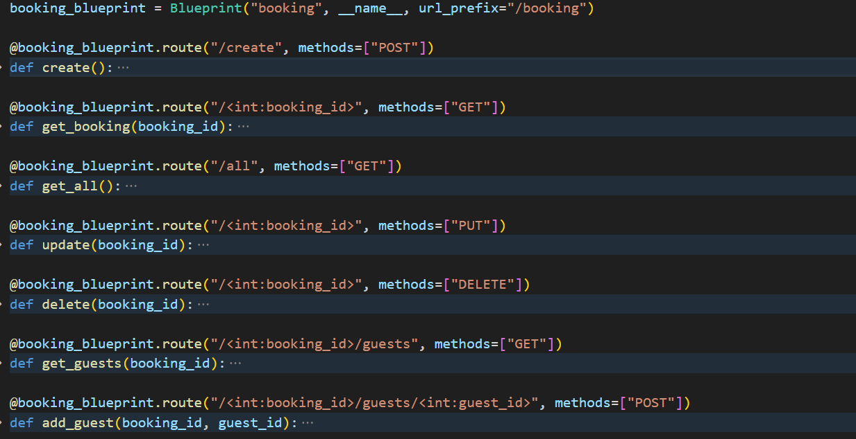
Live Demo
Frontend Website: http://127.0.0.1:5000/
Backend Website: http://127.0.0.1:5001/

Slide 5
Summary
Fun project to work on
Learned a lot
Difficulties encountered:
Working with Flask/Python
Communication

